Slide 1
Text Mining with HathiTrust
An Introduction for Librarians

Slide 2
Set up instructions
Handout p. 1
Create HTRC account: analytics.hathitrust.org
Find workshop materials:
https://uofi.box.com/v/HTRC-fall2019
https://go.illinois.edu/htrc-workshop

Slide 3
Eleanor Koehl Associate Director for Outreach & Education, HTRC efdkoehl@hathitrust.org
Ryan Dubnicek
Digital Humanities Specialist, HTRC
rdubnic2@illinois.edu

Slide 4
Introduce yourself to your neighbor

Slide 5
Workshop outline/structure
Introduction
Text as data
Break (20 min)
Research with text data
Lunch (60 min)
Text analysis methods
Break (20 min)
Text analysis workflows
Other HTRC services

Slide 6
Introduction

Slide 7
In this section we will…
Briefly introduce HathiTrust and its Research Center
Define text analysis
Introduce our case studies

Slide 8
HathiTrust
Digital library partnership
More than 150 member institutions
Founded in 2008
Grew out of large-scale digitization initiative at research libraries
Roots in Google Books project
Notes:
HathiTrust is a library consortium founded in 2008, a community of research libraries committed to the long-term curation and availability of the cultural record.
It is as an offshoot of the Google Books project, and most digitization has happened at academic research libraries.
Currently, it has grown to over 120 partner institutions, mostly in the US, but also abroad.

Slide 9
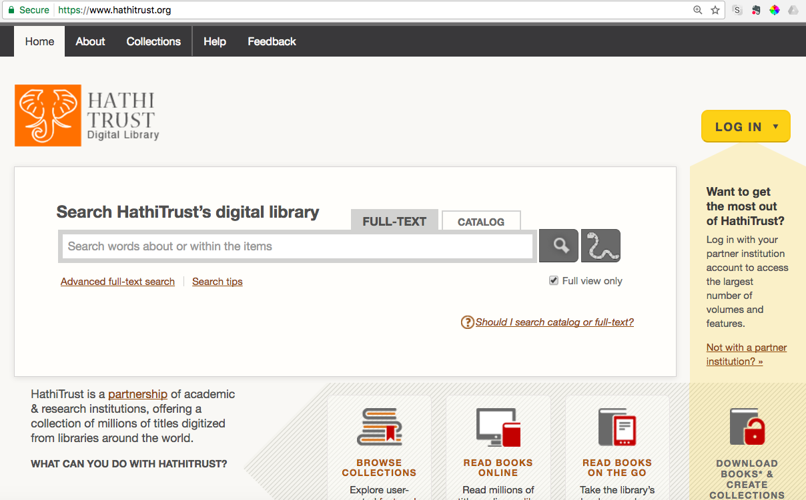
HathiTrust Digital Library
17+ million volumes
62% in copyright or of undetermined status
Search and read books
in the public domain
Notes:
The HathiTrust Digital Library is concerned with collecting, preserving, and providing access to the content digitized at the partner institutions, mostly digitized books from libraries.
HTDL contains over 16 million volumes made up of more than 5 billion total pages. Over half of the volumes are in English. It has material going back to the 15th century, though the majority of the content comes from the 20th century. As a result of the 20th century concentration, about 63% of the material is in copyright or restricted because its rights status is unknown, and about 37% is in the public domain. The HT has a review project for determining rights statuses for that chunk of “unknown” material. While the HTRC is getting set-up to provide access on certain terms to in-copyright content, for now it provides access to the 37% of the HTDL that’s in the public domain.
The HTDL has its own interface for searching, reading, and building collections of volumes in the public domain.

Slide 10
HathiTrust Research Center
Facilitates text analysis of HathiTrust content
Research & Development
Located at Indiana University and the University of Illinois
With support from HathiTrust
Notes:
The HTRC is concerned with allowing users to gather, analyze and produce new knowledge primarily via computational text analysis. It facilitates large-scale computational research of HTDL content. The “center”, which is located at Indiana University and the University of Illinois, does various R&D for non-consumptive text analysis, a concept that we will be explaining in later slides. It conducts user studies, finds cutting-edge technical solutions, and builds tools and services.

Slide 11
HTRC Analytics
https://analytics.hathitrust.org
Notes:
HTRC Analytics is the main website for HTRC, and it’s home to HTRC’s tools, datasets, and virtual programming environments.

Slide 12
What is text analysis?
Using computers to reveal information in and about text
Algorithms discern patterns
Text may be “unstructured”
More than just search
Everyday examples
Seeking out patterns in scientific literature
Identifying spam e-mail
Notes:
Our first topic is what exactly is text mining, or text analysis?
Text analysis a subset of data analysis. Broadly speaking, it’s the process by which computers are used to reveal information in and about text (Marti Hearst definition). Computer algorithms can discern patterns in bodies of (often unstructured) text. ”Unstructured” means that little is known about the semantic meaning of the text data and that it does not fit a defined data model or database. An algorithm is simply a computational process that creates an output from an input. In text analysis, the input would be the unstructured text, and the output would be indicators to help you reveal different things about the text. It should be noted that text analysis is more than just search, meaning it’s not just about discovery and knowing something is there. It’s also about exploring what does it mean for something to be there. For instance, knowing the word “creativity” appears in x number of volumes is only the first step; we also want to know what does this tell us.
Text analysis can be used for a variety of purposes. It can be used for exploratory and analytical research, such as seeking out patterns in scientific literature to pick up trends in medical research otherwise difficult to see from the vantage point of an individual reader. It can also be used in developing tools that we use in our daily lives, for example creating spam filters to identify spam e-mail.
We’ll look at more in-depth research examples as we go along.

Slide 13
How text analysis works (generally)
Break textual data into smaller pieces
Abstract (reduce) text so that a computer can crunch it
Counting!
Words, phrases, parts of speech, etc.
Computational statistics
Develop hypotheses based on counts of textual features
Notes:
So how does text analysis work in general? Text analysis usually follows these steps:
First, the text needs to be transformed from a form that human readers are familiar with to something that the computer can “read”. This means we need to break the text into smaller pieces, and abstract (reduce) it into things that a computer can crunch.
Counting is often what happens next. Some of the things that are often counted include words, phrases, and parts of speech. The number of these counts can be used to identify characteristics of texts.
Then, researchers can apply computational statistics to the counts of textual features, and develop hypotheses based on these counts.

Slide 14
Non-consumptive research
Research in which computational analysis is performed on text, but not research in which a researcher reads or displays substantial portions of the text to understand the expressive content presented within it.
Complies with copyright law
Foundation of HTRC work
Other terms: non-expressive use
Notes:
HTRC tools and services operate within a “non-consumptive” research paradigm.
This is a term for text analysis research that lets a person run tools or algorithms against data without letting them read the text. The precise definition is shown here on the slide (Research in which computational analysis is performed on text, but not research in which a researcher reads or displays substantial portions of the text to understand the expressive content presented within it).
Non-consumptive research complies with copyright law because of the distinction in law between “ideas” and “expressions”. It is sometimes called non-expressive use (because it works with “ideas” instead of specific “expressions”, hence the term “non-expressive”).
The non-consumptive research paradigm is the foundational underlying structure of HTRC work.

Slide 15
Non-consumptive paradigm
Includes such computational tasks as:
text extraction
textual analysis and information extraction
linguistic analysis
automated translation
image analysis
file manipulation
OCR correction
indexing and search
More here: https://www.hathitrust.org/htrc_ncup
Notes:
In concrete terms, here are the kinds of analysis activities we believe falls within the non-consumptive research paradigm. It includes tasks such as: text extraction, textual analysis and information extraction, OCR correction, and indexing and search.

Slide 16
HTRC’s non-consumptive framework
Notes:
There a several ways non-consumptive access can be structured.
Partial: access to the full data is limited, but the outputs from analysis are open, and the tools are also open
Transform: the data is preprocessed or transformed before access is provided, which means that both the output and access to the transformed data is open
Capsule: in the capsule approach, access to full data is allowed, but the output and access are highly controlled

Slide 17
Three Approaches
Partial
Web-based tools: To analyze and visualize text data
Transform
Derived Datasets: Including Extracted Features dataset
Capsule
Secure Data Capsules: For flexible, self-directed research
Notes:
HTRC translates the 3 models for non-consumptive research into 3 distinct approaches…
Web based tools (i.e. partial)
Derived datasets (i.e. transform)
Secure data capsules (i.e. capsule)

Slide 18
HTRC Extracted Features
Derived Data
Downloadable JSON dataset
Per-volume files of metadata and data elements
Periodically updated
Data Capsule service
Secure compute environments
Researcher imports tools
Access to data
Export only derived results
Web tools
Off-the-shelf analysis and visualization tools
Transform
Capsule
Partial
HathiTrust + Bookworm
HTRC Analytics
feeds
Feeds into
Feeds into
Converted into
HathiTrust text corpus
synched nightly, lives at IU
Notes:
Here is another way of visualizing that 3-pronged approach. HTRC syncs updates to its copy of the HathiTrust corpus nightly. Then, that data can be pushed out through the 3 options already described. First, the data can be transformed into the derived dataset called Extracted Features. The data can also be analyzed via web-based algorithms or it can be analyzed within an HTRC data capsule.

Slide 19
Case studies
Inside the Creativity Boom (Samuel Franklin)
The Transformation of Gender in English-Language Fiction (Ted Underwood, David Bamman, and Sabrina Lee)
How Capitalism Changed American Literature (Dan Sinykin)
Notes:
And a quick note: In this workshop, we’re going to be focusing on 3 case studies of research performed using HTRC tools and data. We’ll come back to them in more detail soon, and we’ll be returning to them throughout the workshop to highlight different concepts and ideas.

Slide 20
Discussion
What examples have you seen of text analysis?
In what contexts do you see yourself using text analysis? What about the researchers you support?
Notes:
Let’s pause for a brief discussion.
What examples have you seen of text analysis?
In what contexts do you see yourself using text analysis? What about the researchers you support?
Instructor facilitates whole-group discussion.

Slide 21
Text as data

Slide 22
In this section we will…
Conceptualize text as data for analysis
Explore HathiTrust as a source for textual data
Get hands-on experience with HathiTrust+Bookworm
Consider the data analyzed in the case studies
Notes:
In this section, we’ll talk about text as as a data source and explore HathiTrust as a source for textual data. We will get hands-on experience with a tool called HathiTrust+Bookworm.

Slide 23
Humanities data
Data is material generated or collected while conducting research
Examples of humanities data:
Citations
Code/Algorithms
Databases
Geospatial coordinates
Can you think of others?
Definition adapted from: NEH, https://www.neh.gov/files/grants/data_management_plans_2018.pdf
Notes:
In a humanities research setting, “Data” can be defined as material generated or collected while conducting research.
Humanities data may include citations, software code, algorithms, databases, geospatial coordinates (for example, from archaeological digs). We can see that humanities data can be very diverse and broad in scope.
Can you think of other examples?
(Answers can be: digital tools, documentation, reports, articles, etc.)
This definition is adapted from the National Endowment for Humanities(NEH)’s definition of ”data” in their document Data Management Plans for NEH Office of Digital Humanities Proposals and Awards. Examples of humanities data are also provided in this document.
https://www.neh.gov/files/grants/data_management_plans_2018.pdf

Slide 24
Text as data
Data quality
Clean vs. dirty OCR
Analyzed by corpus/corpora
Text corpus: a digital collection OR an individual’s research text dataset
Text corpora: “bodies” of text
Notes:
We’re not always used to thinking about text as data, but text can be viewed as data and analyzed in certain ways in digital scholarship.
When approaching text as data, here are some things to keep in mind:
First, having textual data of sufficient quality is important. Textual data quality is determined by how it’s created. Hand-keyed text is often of the best quality, while text obtained by OCR, Optical Character Recognition, can vary in quality. Raw, uncorrected OCR text is dirty, and it can only become clean until it is corrected. Please note that HathiTrust OCR is dirty and uncorrected.
When viewing text as data, we usually analyze them by corpus or corpora. As mentioned in previous modules, a “corpus” of text can refer to both a digital collection and an individual's research text dataset. Text corpora are bodies of text.
When preparing text, one can think in terms of what Geoffrey Rockwell has called text decomposition or re-composition. The text will be split, combined, or represented in ways that distinguish it from human readable text. It may involve discarding some text, and requires the researcher to shift their understanding of the text from human-legible object to data. What stays, what goes, and how things are manipulated is a researcher’s choice. While there are emerging best practices, there isn’t a step-by-step guide to follow.

Slide 25
Data in HathiTrust
Metadata
Primarily bibliographic (MARC) metadata
Example
Structural metadata (METS)
Full text data
OCR text
Generated automatically during the digitization process
It’s dirty (uncorrected)
Notes:
HathiTrust data is in the form of metadata and full text data
The metadata is primarily bibliographic metadata that comes to HathiTrust in the form of MARC catalog records submitted by the contributing libraries. Once they come in, these records are augmented—though not corrected—and stored by HathiTrust.
The MARC metadata is made available in several forms. You can see it on the web under the “catalog record” for an item. The full record (with all the data) is not easily downloaded at this time, although you can access abbreviated records via several means, including a bibliographic API and a big, tab-delimited file called the HathiFiles.
There is also full text data, generated through Optical Character Resolution automatically during the digitization process. That means that the OCR quality is variable based on the characteristics of the original item and the software used to do the OCR (which has gotten better with time). The OCR is also not hand-corrected or market up, so it would be considered dirty OCR.

Slide 26
Publication dates in HTDL
https://www.hathitrust.org/snapshot-of-hathitrust-collection-10-years
Notes:
Let’s take a closer look at what’s in HathiTrust.
Here’s a graph showing the publication dates for items in the HathiTrust corpus. You’ll see that there are scant items from the 16th to the 18th century, and then it spikes around 1900 and again around 1980.
This graph is pulled from a post called the “Snapshot of the HathiTrust Collection at 10 Years”

Slide 27
Languages in HTDL
https://www.hathitrust.org/snapshot-of-hathitrust-collection-10-years
Notes:
Here’s a graph showing the top languages in HathiTrust. English-language works have always been the most prevalent in the collection, through their overall share of has gone down over the last 10 years. Other prevalent languages are German, French, Spanish, and Japanese.

Slide 28
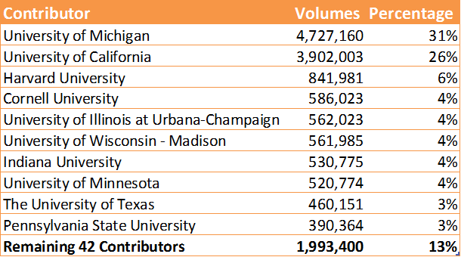
HathiTrust sources
Top 10 Contributors to HathiTrust as of March 2017
Notes:
HathiTrust does not scan any content itself. Instead, member libraries scan materials and deposit them into the collection.
The HTDL mirrors the collections of the member libraries. The University of Michigan and the University of California campuses are our most prolific contributors, followed by other institutions that are part of the Big Ten Academic Alliance.

Slide 29
HathiTrust collection: US Federal Gov Docs
1,232,294 separate digital objects
Fed Docs Registry: Attempt to id all US fed docs ever created
https://www.hathitrust.org/usdocs_registry
Federal Documents collection description https://www.hathitrust.org/blogs/perspectives-from-hathitrust/federal_documents_collective_collection
Notes:
The content in HathiTrust is largely determined by the digitization priorities of contributing member libraries. There have been some efforts to build up certain areas of the collection, for example US Federal Government Documents. The Fed Docs collection in HathiTrust consists of nearly 1 million digital objects, and as part of the Fed Docs collection development project, the team working on it created a registry that attempted to identify every US Fed Doc ever created.

Slide 30
Collection visualization: HathiTrust + Bookworm
Brings together:
Text data (unigrams)
Bibliographic metadata
Visualization tool
Track trends in a repository
HathiTrust
Bookworm
Notes:
Bookworm is a tool that visualizes language usage trends in repositories of digitized texts in a simple and powerful way.
It is a tool that facilitates the observation of chronological trends for words and phrases in large digitized collections of textual documents with metadata facets.
HathiTrust + Bookworm can visualize word frequencies over time in texts from the HathiTrust Digital Library. Currently, only unigrams (single words) can be searched and visualized with HT+Bookworm.

Slide 31
Bookworm visualization framework
Visualizes categories
The category is plotted along the x-axis
Often plot years along the x-axis
Can plot other things!
HathiTrust+Bookworm is just one implementation of the framework
Adapted from Ben Schmidt, “Bookworm API Philosophy”
Notes:
Normal search engines are very good at finding individual texts: Bookworm is good at finding and understanding categories in a library.
The simplest use case is returning usage of a word across years: the goal here is to understand something about the years through the words they use.
Bookworm is a framework that can be applied to other corpora. The HT+BW version is just one implementation!

Slide 32
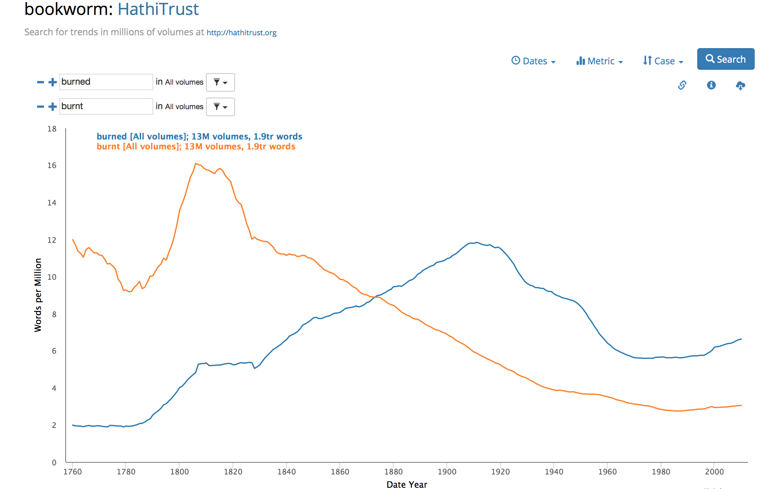
Reading an HT+BW graph
Burned vs. Burnt
Do you see any trends?
Notes:
To quantify the dynamics of language evolution, Aiden et al. studied the regularization of English verbs over hundreds of years. His group originally conducted a manual study first and published the results in Nature in 2007, and then proceeded to study this phenomenon further using computational methods in 2007.
They called this approach Culturomics, defined as “the application of high-throughput data collection and analysis to the study of human culture”.
One of their examples was “burned” vs “burnt.” Let’s try!
(Instructor should demo this segment live if possible and use the screenshots in the slides as backup)
Search “burned” and “burnt” in Bookworm. They both work as the past tense and past participle of the verb “burn”, but has the usage of the two changed over time, respectively? After visualizing the usage of the two words in Bookworm, we can see that before the 1860s, “burnt” was used more than “burned”, but afterwards it became the opposite.
You can try visualizing other sets of verbs in Bookworm. Do you see any trends?

Slide 33
Key terms in text analysis
N-gram
A contiguous chain of n items from a sequence of text where n is the number of items. Example: Bigram.
[it is], [is navigable], [navigable for], [for such], [such vessels], [vessels as], [as can], [can pass], [pass the], [the bar], [bar to], [to within], [within a] [a very], [very short], [short distance], [distance of], [of the], [the town], [town beyond], [beyond which], [which it], [it is], [is too], [too shallow], [shallow even], [even for], [for boats]
Notes:
In the next section, we will be introducing you to HathiTrust+Bookworm. But first, let’s return briefly to a term we learned about earlier in the text pre-processing module.
N-grams are a contiguous chain of n-items (i.e. words) where n is the number of items in the chain. Notice how in the bigram example on the screen the window of the gram slides across the text, so in bigrams, a word will occur with both the word preceding and following it.
HathiTrust+Bookworm makes use of unigrams – or single words.

Slide 34
Bookworm functionality
Search for unigrams (single words)
Facet on metadata
Adjust the years on the X-axis
Visualize word trends across the corpus
Notes:
The basic functionality of Bookworm is 1) search on one or more unigrams (single word terms), 2) facet your search on the metadata, such as place of publication, book or serial, and Library of Congress classification, 3) adjust the years on the X-axis, and 4) review the visualization.

Slide 35
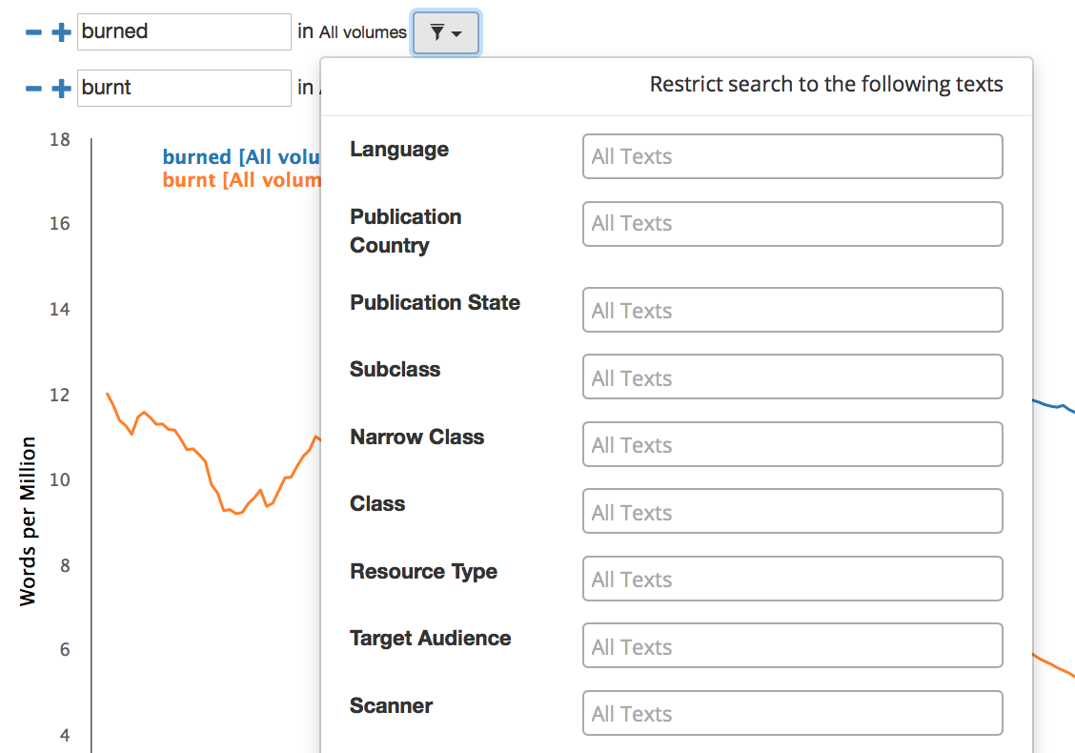
Bookworm interface
Limit your search
with facets
https://bookworm.htrc.illinois.edu/develop
Notes:
Now let’s take a closer look at the Bookworm interface.
Link to HT+BW page: https://bookworm.htrc.illinois.edu/develop
(Instructor should demo this segment live if possible and use the screenshots in the slides as backup)
Begin a search by typing in a word in the search column. You can click on the plus and minus signs next to the search columns to add or reduce the number of columns to search for multiple words at the same time for comparison. By clicking on the funnel icon next to “All texts”, you can also limit your search with facets, for example “Language” or “Publication Country”.

Slide 36
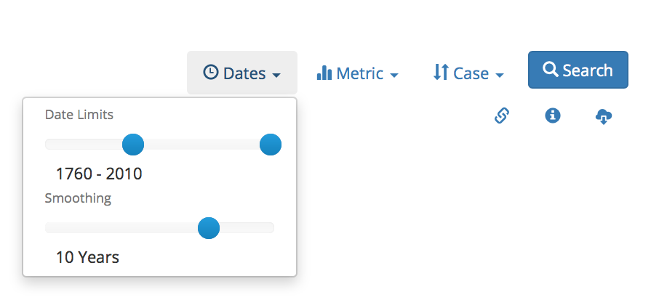
Bookworm interface
Fine-tune your results
Notes:
By clicking on the “Dates”, “Metric”, and “Case” tabs on the top right corner of the page, you can also fine-tune your results by controlling the time period, changing metrics, switching between case-sensitive and case-insensitive, and smoothing with different parameter settings. When you’re all set, hit the “Search” button to generate the visualization.

Slide 37
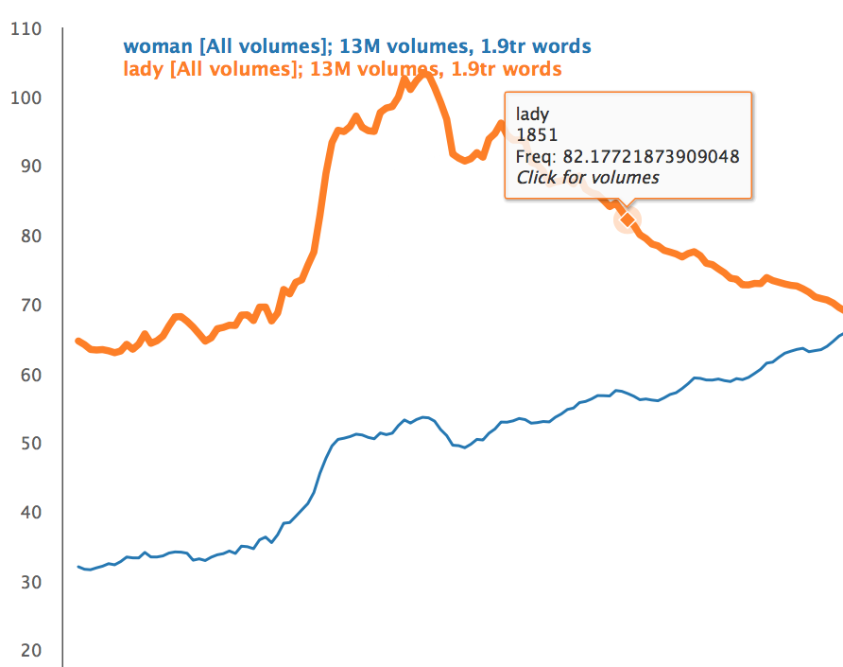
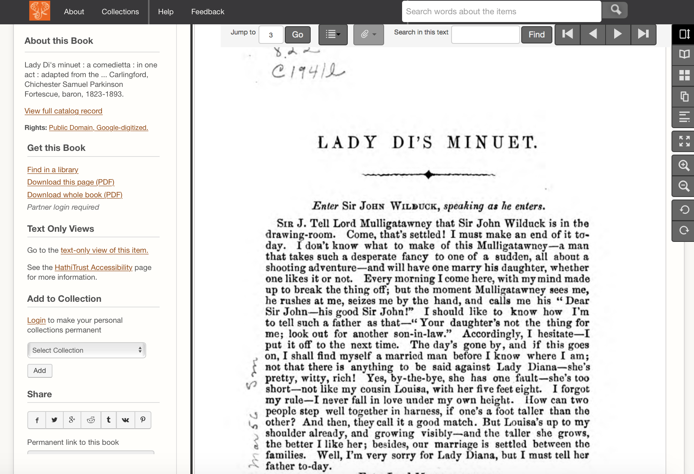
Bookworm interface
Links directly to texts in the HTDL
Notes:
If everything goes well, your visualization will appear on the screen. When you point your cursor to a specific spot on a curve, a window will display the option “click for texts”. After a single click, another window that shows the top results of your searched word in that year will appear. You can then click on the name of each entry to be directed to its corresponding volume in the HathiTrust Digital Library.

Slide 38
Hands-on activity
Handout p. 1
Use HT+BW to explore lexical trends
Website: https://bookworm.htrc.illinois.edu/develop
Notes:
For our hands-on activity, you will use HT+BW to visualize lexical trends related to your own research interests.
Access HT+BW from the link on the slide and try searching some terms. Be creative and feel free to experiment! Also, try using faceting to get more interesting results.
INSTRUCTOR MAY DEMO LIVE IN WORKSHOP.
If time runs short, while introducing the activity, ask participants to share their results in pairs very briefly as soon as they finish exploring on their own. In this way, the discussion can be folded into the hands-on activity and take up less time.

Slide 39
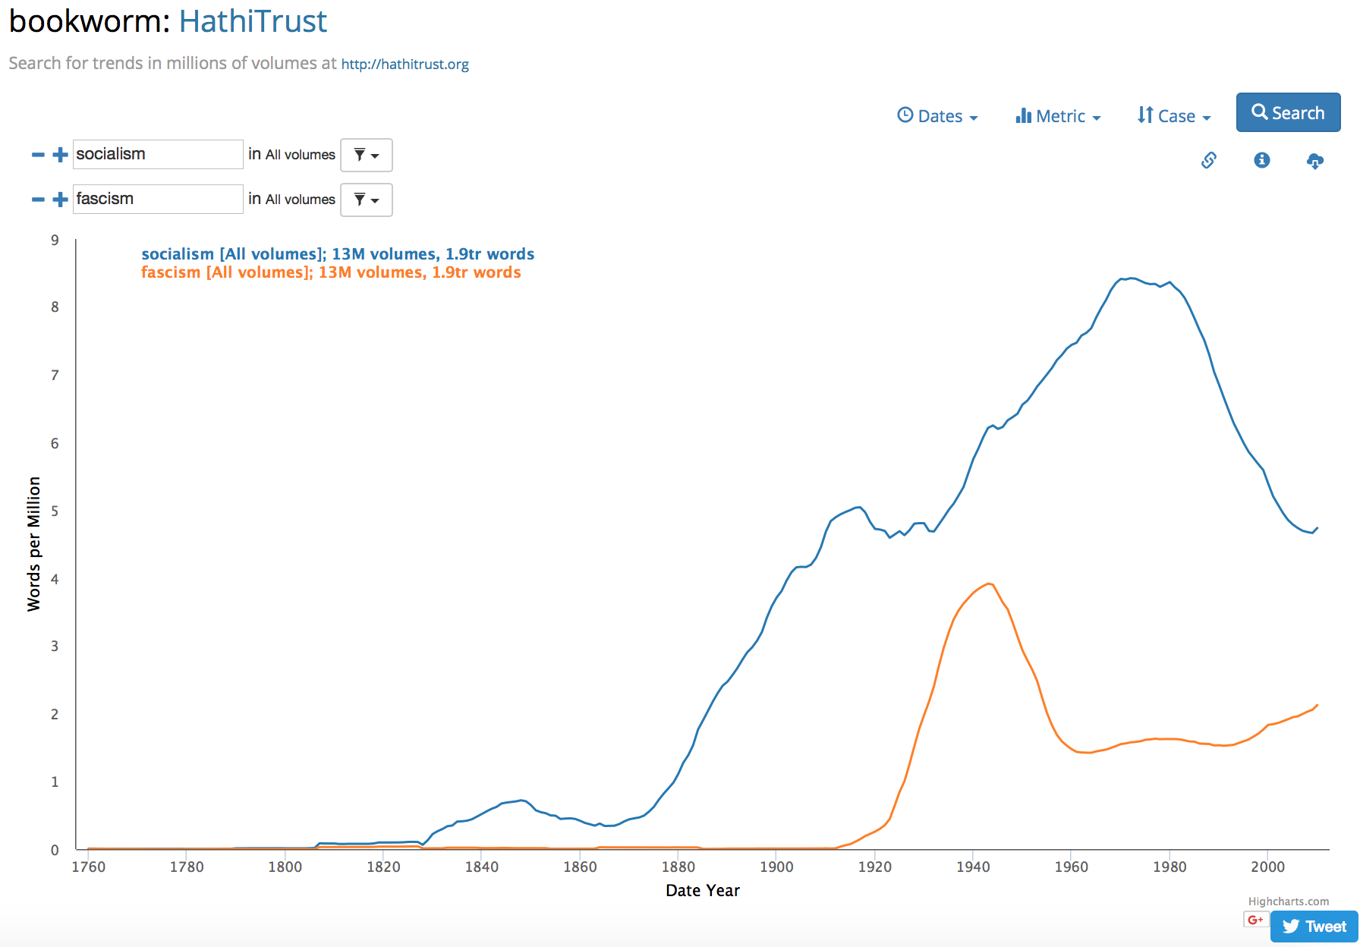
Examples
Notes:
If you are interested in political concepts, here is one example to try. Use HT+BW to visualize “socialism” and “fascism”. Do you see any trends?
Example 1: Socialism vs. fascism

Slide 40
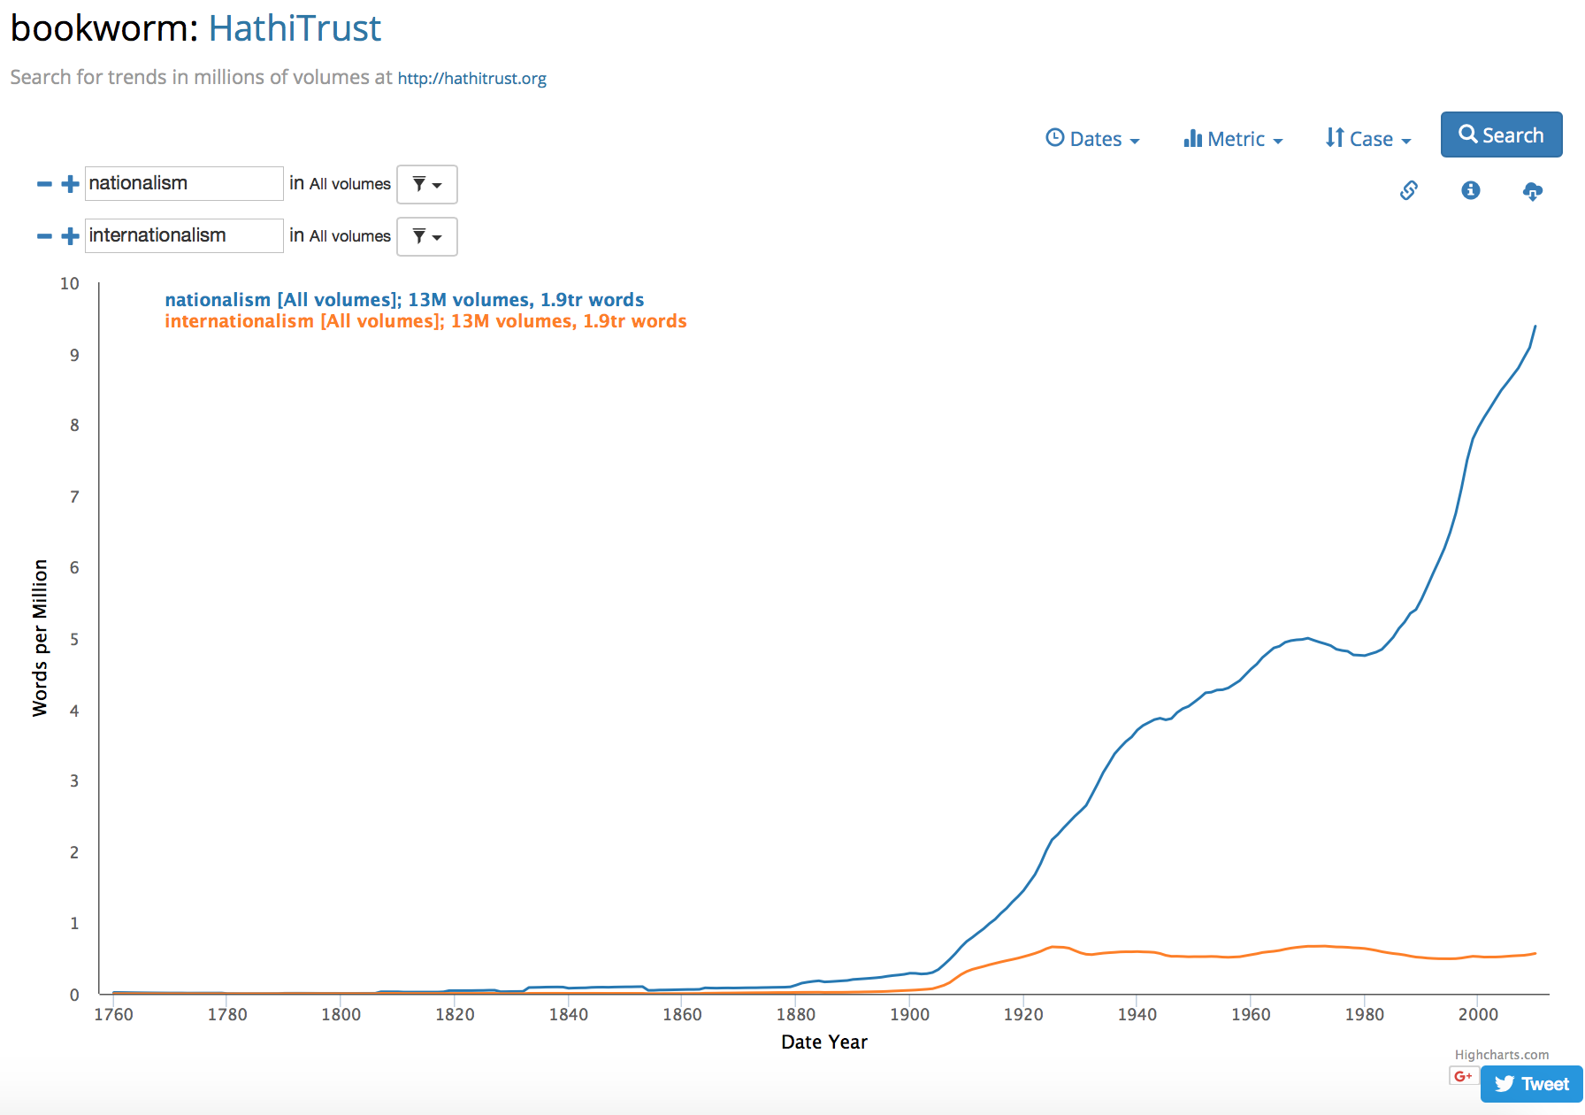
Examples
Notes:
Another example is graphing “nationalism” and “internationalism”. Do you see any trends?
Example 2: Nationalism and internationalism

Slide 41
HathiTrust data access options
Method | Data | Description | Rights status | Restrictions
HT dataset request | Full text OCR | Download plain text OCR | Public domain | Depends on your university
HT Data API | Full text OCR, page images | Download page images and plain text OCR | Public domain | Non-Google digitized only
HTRC Algorithms | Full text OCR (not viewable) | Analyze a workset using off-the-shelf tools | All | Data can be computed on, but is not exposed
HTRC Extracted Features | Abstracted text and metadata | Download JSON files for each of 15.7 million volumes in HathiTrust | All | Data is preprocessed
HTRC Data API | Full text OCR | Analyze plain text OCR | All for HT members; else public domain | For use in a Data Capsule only
Notes:
One of the most confusing pieces of getting started with HathiTrust for text analysis is understanding what data is available to you where, and in what format. You don’t need to memorize this table, but hopefully it helps clarify that there a multiple data access options, with different formats and rights statuses available, and with different restrictions. Choosing which one to work with will depend on the needs of the researcher and the research project. For example, a researcher who wants full text, public domain data to work with on their own computer can request a dataset from HathiTrust – that can include up to the entire public domain set of content from HathiTrust. A researcher who wants to work with data from in-copyright volumes on their own computer might instead choose the HTRC Extracted Features dataset, so long as the preprocessing that is done to create the files-–which we will explore in more detail later—is compatible with their research needs.

Slide 42
Building corpora
Identify texts through full text search
Use a key term or phrase
Identify texts through metadata
Date range, author’s names, etc
Match to a list of known items, such as a bibliography
Notes:
Next, we will talk about the process of building corpora. Text corpora are bodies of text.
A researcher starts building corpora by first identifying texts that fit their specific research needs. This usually involves finding texts that contain a key term or phrase through a full text search.
According to the specific research question, one can also identify texts through metadata, for example searching for texts written by certain author(s), that are within a particular date range, or of a specific genre.
Some researchers also have a list, like a bibliography or best seller’s list, and they want to build a corpus of those items.

Slide 43
Building corpora
Identify the best dataset available to the researcher, with minimal bias
Techniques (Bode, 2019)
Statistical – primarily rely on sampling and statistical modeling to identify gaps and outliers to reduce bias
Scholarly – engage in a practice of historicizing the data prior to analysis to assess potential biases imposed by what is available, and in what format
Notes:
As we’ve been suggesting, researchers take different approaches to building corpora for analysis, and what methods they use will depend on their research question and preferences. There is an open debate within digital humanities about corpus construction.
When building a corpus, especially from a large collection like HathiTrust, it’s important to consider what’s there as much as what’s not there. No matter their approach, the researcher’s goal is to identify the best, most complete or representative dataset available to them, while minimizing bias in their selection.
2 techniques for building corpora described by Katherine Bode in a recent paper are statistical and scholarly approaches. The statistical approach primarily relies on sampling and statistical modeling to identify gaps or outliers in a corpus. While some historicizing may occur, the idea is that bias can be reduced through modeling. In the scholarly approach, the data is historicized prior to analysis to assess potential biases. The scholarly approach aligns itself with scholarly editing, and encourages a deeper understanding of the means by which the data was created.

Slide 44
Building corpora
Process usually involves deduplication
What to keep/discard is project dependent
Examples of deduplication:
OCR quality
Earliest edition
Editions without forewords or afterwords
Notes:
The process will also typically involve doing some deduplication, which means getting rid of multiples of volumes. What to keep and discard will be dependent on the specific needs of the project. Some examples of deduplication a researcher might choose include: choosing the volume with the best OCR quality, choosing the earliest edition, or choosing editions without forewords or postscripts.

Slide 45
Case studies: Characterize the data used
Handout p. 2
Read all 3 case studies
Then characterize the data used, such as:
What criteria did they use to build their corpus?
What was the period of study?
Can you tell if they have access to full-text?
Notes:
Now, let’s get into our case studies. This is our first time reading them, but we’ll have plenty of time through the day to come back to each one. As you read each one, focus on the data they used. See if you can answer these 3 questions. Feel free to skim through details about methodology and outcomes.

Slide 46
HTRC Worksets
User-created collections of text from the HathiTrust Digital Library
Think of them as textual datasets
Can be shared and cited
Suited for non-consumptive access
Notes:
Now, let’s look specifically at how the HTRC can provide access to textual data and assist users in building up a text corpora for analysis.
HTRC Worksets are one way the HathiTrust allows users to create text corpora to analyze. A workset is a user-created collection of texts from the HathiTrust Digital Library. You can think of them as textual datasets.
The idea behind worksets is that researchers can build their own collections, which is something they are used to doing also in the analog world, and these worksets can be cited by and shared with other users, which helps encourage ensuring reproducibility (for example, other people can test your results when they run the same analysis on your shared worksets).
Worksets are also suited for non-consumptive access, which you may remember means users cannot directly “consume” the text in full, but can run tools or algorithms against data for research analysis.

Slide 47
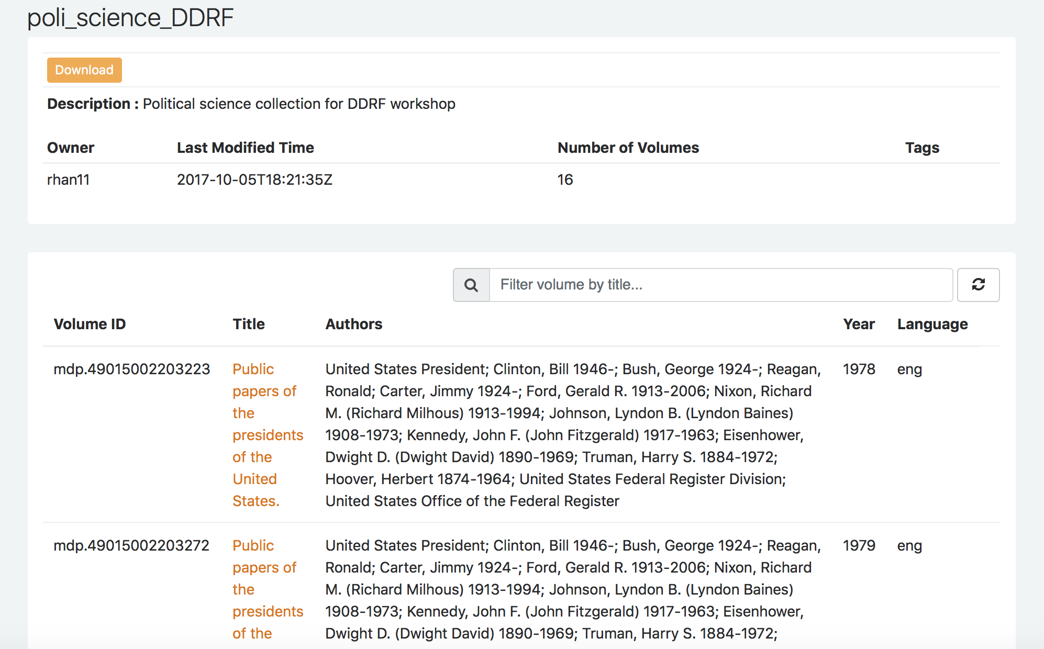
HTRC Worksets
mdp.49015002221845
mdp.49015002221837
mdp.49015002221829
mdp.49015002221787
mdp.49015002221811
mdp.49015002221761
mdp.49015002221779
mdp.49015002203140
mdp.49015002203157
mdp.49015002203033
mdp.49015002203231
mdp.49015002203249
mdp.49015002203223
mdp.49015002203405
mdp.49015002203272
mdp.49015002203215
Workset viewed on HTRC Analytics
Workset manifest
Notes:
When you view a workset on HTRC Analytics, you’ll get metadata about the volumes in the workset. You cannot read the text in this interface. At its core, the workset is just a manifest of volume IDs.
Volumes IDs are the unique identifiers for volumes in HathiTrust. They consist of a prefix that corresponds to the institution where the items came from and then a string of numbers. For example, MDP is the code for Michican, the University of California system uses UC1 and HVD is Harvard.

Slide 48
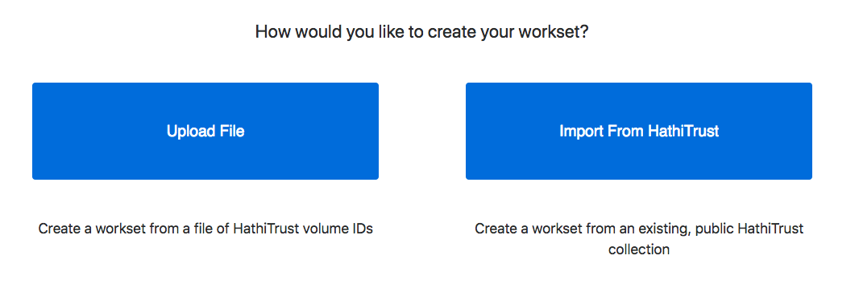
Creating HTRC Worksets
Notes:
Worksets can be created in 2 ways. First, if you have a list of volume IDs, a manifest, you can upload the file to create a workset. All the file needs is a list of volume IDs, no other metadata is required. One way you might have a list of volume IDs is by reusing a list created by another researcher. For example, Ted Underwood has released the volume information for items his analysis recognized as being poetry, prose, or non-fiction. So if you were looking for fiction in HathiTrust, you might start from Ted’s list and work backward to the volumes you wish to study.
You can also import a collection created in the HathiTrust Digital Library interface as a workset via a “one click” function.

Slide 49
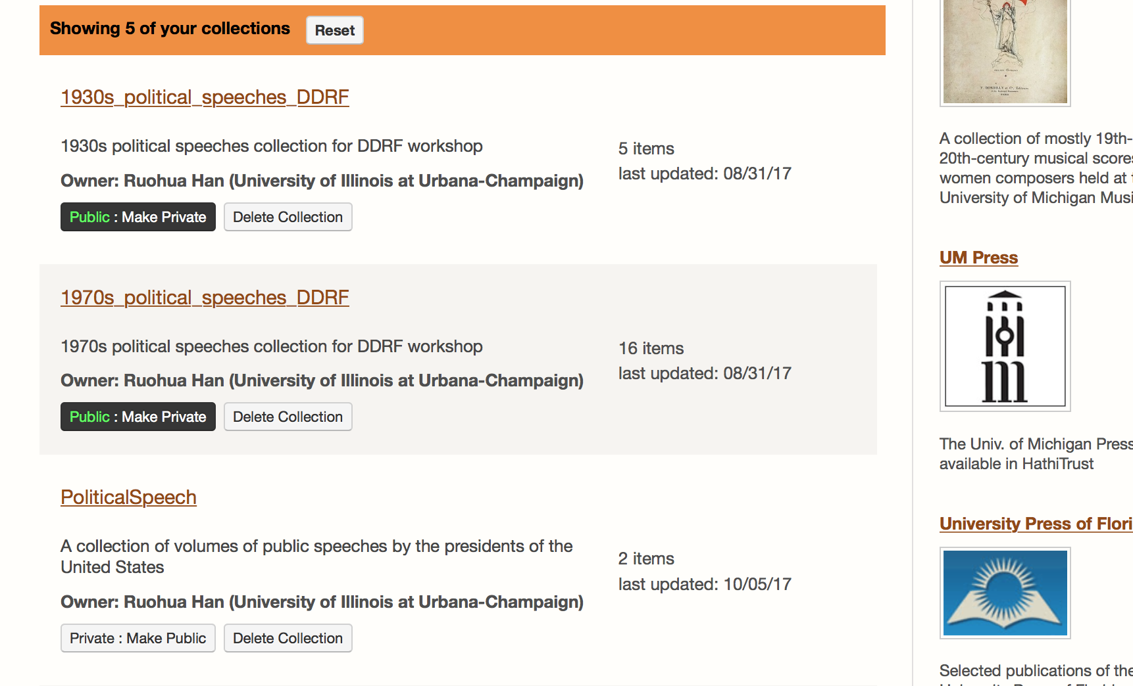
HathiTrust user-created collections
To find, go to www.hathitrust.org
Then, click ‘Collections’ at top
Notes:
Anyone is able to build collections in HathiTrust by searching, selecting, and adding items to their collection. The collections are useful also as general research collections for scholars. They also have the ability for you to do a full text search within the collection.

Slide 50
Read and reflect
Handout p. 2
Santa Barbara Statement on Collections as Data (Collections as Data National Forum, 2017)
https://collectionsasdata.github.io/statement/
Provides a set of high level principles to guide collections as data work
Notes:
Let’s wrap up this lesson with a discussion based on a short reading.
The Santa Barbara Statement on Collections as Data was initiated during an Institute of Museum and Library Services national forum at the University of California Santa Barbara (March 1-3 2017). It provides a set of high level principles to guide collections as data work.
We will read some parts of the Statement and discuss the development of digital collections in libraries.
(Short discussion for 5-10 minutes.)

Slide 51
Read and reflect
Handout p. 2
“With a few exceptions, cultural heritage institutions have rarely built digital collections or designed access with the aim to support computational use.”
“Any digital material can potentially be made available as data that are amenable to computational use. Use and reuse is encouraged by openly licensed data in non-proprietary formats made accessible via a range of access mechanisms that are designed to meet specific community needs.”
“Ethical concerns are integral to collections as data.”
-- Santa Barbara Statement on Collections as Data
Notes:
Some main points from the Statement are shown on the slide.
Digital libraries and digital collections contain many textual documents, which can potentially be made available as data for computational use. Principle 2 of the Statement states “Collections as data development aims to encourage computational use of digitized and born digital collections.”
Read full Statement here: https://collectionsasdata.github.io/statement/
(Short discussion for 5-10 minutes.)

Slide 52
Read and reflect
Handout p. 2
Does your library provide access to digital collections as data?
How so? Why not? How could it?
Notes:
Think about the collections available at your library. Does your library provide access to digitized materials in a way that is conducive to text analysis? If so, how? If not, why? How could it be more conducive to text analysis?
(Short discussion for 5-10 minutes.)

Slide 53
Break (20 minutes)

Slide 54
Research with text data

Slide 55
In this section we will…
Recognize the steps taken to prepare text data
Run the HTRC’s Named Entity Recognizer
Explore text analysis research questions

Slide 56
Moving beyond the book-like object
Text decomposition/recomposition (Rockwell, 2003)
Cleaning data involves discarding data
Prepared text may be illegible to the human reader
Text may be chunked or grouped
Chunking = dividing the text into smaller pieces ( paragraphs, 1000 words, pages)
Grouping = combining smaller pieces of data together
Notes:
When preparing text, one can think in terms of what Geoffrey Rockwell has called text decomposition or re-composition. The text will be split, combined, or represented in ways that distinguish it from human readable text. It may involve discarding some text, and requires the researcher to shift their understanding of the text from human-legible object to data.
The data may be divided or combined – chunked or grouped – in ways that make it distinct from how it was published as a book-like object. Sometimes that means trying to identify articles or chapters from within one item, or chunking the text into 1000 word chunks that can be fed into an algorithm. It can also mean concatenating files to group the text into one unit whereas they may have existed separately.

Slide 57
Steps to prepare text data
Correct OCR errors
Remove title, header information
Remove html or xml tags
Split or combine files
Remove certain words, punctuation marks
Lowercase text
Tokenize the words
Notes:
After gathering the data needed for research and before conducting the actual analysis, data often requires preparation. Preparing data, which has been referred to as “janitorial work,” takes a lot of time and effort. What stays, what goes, and how things are manipulated when preparing data is a researcher’s choice. While there are emerging best practices, there isn’t a step-by-step guide to follow.
Examples of what may be necessary to do before the data is in a workable state:
Correcting OCR errors.
Removing title and header information.
Removing html or xml tags.
Splitting or combining files.
Removing certain words or punctuation marks.
Making text into lowercase.
This is where scripting is helpful – a person isn’t going to (or shouldn’t) open every file one-by-one and do all this clean-up work manually.

Slide 58
Key concepts in text analysis
Tokenization
Breaking text into pieces called tokens. Often certain characters, such as punctuation marks, are discarded in the process
[it] [is] [navigable] [for] [such] [vessels] [as] [can] [pass] [the] [bar] [to] [within] [a] [very] [short] [distance] [of] [the] [town] [beyond] [which] [it] [is] [too] [shallow] [even] [for] [boats]
Notes:
An additional step in preparation is called tokenization. Tokenization is simply the process of breaking text into pieces called tokens. Often certain characters, such as punctuation marks, are discarded in the process.
Here’s a tokenized version of the beginning of a sentence from The Modern Traveller on the slide. The original text, which is in a human-readable form, has been translated into tokens.
While the tokens can still be parsed by a human, it isn’t in a form we regularly read. It can now, however, be read and processed by a computer.

Slide 59
Hands-on Activity
Handout p. 3-4
In groups of 2 or 3, assign each person several of the text preparation actions seen in the table to the right (Denny and Spirling, 2017).
Read the descriptions. Then take turns explaining each to your group.
Term
Punctuation
Numbers
Lowercasing
Stemming
Stopword Removal
n-gram Inclusion
Infrequently Used Terms
Notes:
Let’s do an activity to learn more about data preparation techniques for text analysis. On your handout, under “Working with Text Data”, you’ll find a table with key approaches and their definitions. In small groups, divide the terms amongst yourselves, read the definitions and when finished, explain your terms to your partners.
These definitions come from an interesting paper titled “Text Preprocessing For Unsupervised Learning: Why It Matters, When It Misleads, And What To Do About It” (https://papers.ssrn.com/sol3/papers.cfm?abstract_id=2849145)
(Instructor organizes the activity. If time runs short, can ask participants to take about 3 minutes to familiarize themselves with the concepts on their own instead of doing the 5-10-minute group discussion)

Slide 60
Case studies: preparing text data
Handout p. 5
Look back at the Creativity Boom case study
Consider the following questions:
What steps did he take to prepare his data?
What assumptions did he make while preparing his data?
Notes:
Now we’re going to dig into the Creativity Boom case study (case study 1). Read through and see if you can find the answers to questions on this slide.

Slide 61
HTRC Named Entity Recognizer algorithm
https://analytics.hathitrust.org/statisticalalgorithms
Notes:
Let’s read the description of one of HTRC’s Algorithms called the Named Entity Recognizer. We’re going to focus on the data preparation steps. Read the “How it works” off the slide or by going to the link shown here.
What data preparation steps that we have discussed do you recognize in this description?

Slide 62
Hands-on activity
Handout p. 5
Run the HTRC’s Named Entity Recognizer algorithm
Website: https://analytics.hathitrust.org/
Notes:
Now, why don’t you run the Named Entity Recognizer on a workset.

Slide 63
The Modern Traveller workset
Notes:
This workset consists of all 30 volumes of The Modern Traveler, written by Josiah Conder and published in 1830. It’s a famous travel narrative. According to Wikipedia “Although Josiah Conder never travelled abroad himself, he compiled all thirty volumes of The Modern Traveller, his non-fiction publishing epic covering the geography of many of countries of the world.”

Slide 64
Navigate to the HTRC algorithms
https://analytics.hathitrust.org
Notes:
HANDS-ON ACTIVITY
The instructions are included in the handout, and you can work alone or with a partner. Raise your hand if you get stuck. I’ll be demoing up here if you’d like to follow along.
Current step(s) in activity:
Make sure you’re signed in to HTRC Analytics
Click “Worsets”

Slide 65
Find the workset
Notes:
Activity
Current step(s) in activity:
Use the search and filter to find the correct workset by first making sure you are viewing All Worksets

Slide 66
Filter by name & select the workset
Notes:
Activity
Current step(s) in activity:
Then start typing the name of the workset we’ll be using The ModernTraveller
Click on the name of the workset

Slide 67
View workset & choose NER algorithm from menu
Notes:
Activity
Current step(s) in activity:
View the volumes in this workset
Using the dropdown menu, choose the Named Entity Recognizer option under Analyze with Algorithm

Slide 68
Input job details & submit
Notes:
Activity
Current step(s) in activity:
Add a job name
The correct workset should already be visible
Choose English for the predominate language
Hit submit

Slide 69
See your job in progress
Notes:
Activity
Current step(s) in activity:
Your job will go from staging to queued to running while it is in active, then it will drop below to the completed jobs
Jobs expire 18 months after they were run, so be sure to download results

Slide 70
View your results
Notes:
Activity
Current step(s) in activity:
View the output of the algorithm
Note that the CSV file can be downloaded
Ask what they think can be done with the output

Slide 71
Hands-on activity
Run 1 or more HTRC algorithms
Use either TheModernTraveller workset or one of your choosing
What does the algorithm do? What results do you get?
Website: https://analytics.hathitrust.org/
Notes:
Time for attendees to explore the various algorithms and see their outputs. Give attendees 10-20 minutes, depending on schedule.

Slide 72
How does text analysis impact research?
Shift in perspective, leads to shift in research questions
“Distant reading” (Moretti, 2013)
One step in the research process
Can be combined with close reading
Opens up:
Questions not provable by human reading alone
Larger corpora for analysis
Studies that cover longer time spans
Notes:
Understanding text via text analysis has a significant impact on how research is being conducted.
In a general sense, the shift in the researcher’s perspective leads to shifts in research questions. Text analysis techniques are sometimes called “distant reading”. This is a term coined by Stanford professor Franco Moretti, meaning “reading” literature not by studying particular texts, but by aggregating and analyzing massive amounts of texts and “reading” them at a “distance”. This scaling-up and “distancing” can bring out more insights from a very different vantage point.
It is also worth mentioning that text analysis doesn’t have to be the primary method in a research project. It may be just one step in the entire process, or it can be combined with close reading. This approach has been called “intermediate reading” or “distant-close reading”.
This shift in research perspective allows for new kinds of research questions to be asked, or for old questions to be “answered” in new ways. Here are some of the possibilities that text analysis can bring to researchers:
It can explore questions not provable by human reading alone
It allows larger corpora for analysis
It allows studies that cover longer time spans
As pointed out by Laudin and Goodwin, text analysis techniques are often best when combined with qualitative assessment and theoretical context.

Slide 73
Text analysis research questions
May involve:
Change over time
Pattern recognition
Comparative analysis
Notes:
Text analysis research questions explore a wide range of topics, from biomedical discovery to literary history. Research questions that are conducive for text analysis methods may involve these characteristics:
Change over time
Pattern recognition
Comparative analysis

Slide 74
Case studies: explore the research question
Handout p. 7
Return to the How Capitalism Changed American Literature case study
Answer the following questions:
What was his research question?
Why is it a good question for use of text analysis?
Notes:
We’re going to spend more time with case study 2. Read through the case study and respond to these questions: what was his research question? And why is his question good for using text analysis methods?

Slide 75
Lunch break

Slide 76
Text analysis methods

Slide 77
In this section we will…
Learn about different text analysis methods
Get started with Python via Jupyter Notebooks
Map the geographic entities you generated earlier

Slide 78
How does Named Entity Recognition work?
How does the computer know a name is a name?
Not just search
Because the algorithm isn’t looking for a list of possible entities, but any entity
Uses semantic, context clues to determine entities
Sentence boundaries
Parts-of-speech
Notes:
Before lunch, we ran the Named Entity Recognizer algorithm. An algorithm is just a way of saying a computer function - text goes in, process happens, and results come out.
It output a file with a CSV of so-called named entities. But how does the computer know a name is a name (or a date a date, a location a location)?
Named Entity Recognition is about more than just search. Let’s use names as an example. We don’t have a list of possible names that we are trying to retrieve from the text, but we want to know find any possible name. There are clues, like the capitalization of words, but finding any capitalized word would yield a lot more than just names.
Instead, NER uses semantic, context clues from the text to determine what is a name. We’re look at the flow for this strand of research in more detail later, but some basic steps include identifying sentence boundaries, and then parsing the tokens in that sentence to determine parts of speech. The algorithm is able to use clues like the part of speech to make a guess about what is a name.

Slide 79
How text analysis works (generally)
Break textual data into smaller pieces
Chunking, tokenizing, or generating n-grams
Abstract (reduce) text so that a computer can crunch it
Counting!
Words, phrases, parts of speech, etc.
Computational statistics
Develop hypotheses based on counts of textual features
Notes:
So how does text analysis work in general? Text analysis usually follows these steps:
First, the text needs to be transformed from a form that human readers are familiar with to something that the computer can “read”. This means we need to break the text into smaller pieces, and abstract (reduce) it into things that a computer can crunch.
Counting is often what happens next. Some of the things that are often counted include words, phrases, and parts of speech. The number of these counts can be used to identify characteristics of texts.
Then, researchers can apply computational statistics to the counts of textual features, and develop hypotheses based on these counts.

Slide 80
Introduction to Python
Python is a scripting language
Good for working with data
Interpreted language → follows step-by-step directions
Relatively straightforward syntax
Avoids excess punctuation
Notes:
Next, we will be introducing Python in this module. Python is a commonly-used programming language, and it’s very useful for working with data. It is also an interpreted language, which basically means it follows step-by-step directions.
Additionally, Python is generally easy to learn with its relatively simple syntax. For example, one of its learner-friendly features is it avoids excess punctuation.

Slide 81
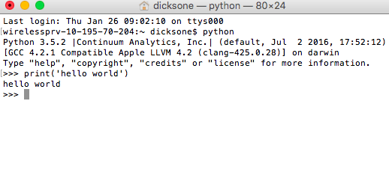
Using Python: Interactive programming
Using a python interpreter
Run each step at the prompt
If you enter “Python” on the command line, you will start the interpreter
We aren’t using it today!
Notes:
We can use Python to do interactive programming in an interactive mode. This is done in the Python interpreter. Each step is input and run via the console, and immediate feedback is given for each statement.

Slide 82
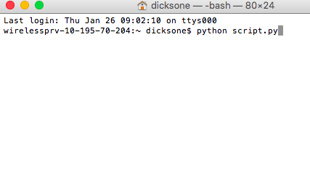
Using Python: Write & run scripts
Scripts are directions for your computer to follow
Save the script as a file ending in .py
On the command line, run the script
Also not running this today!
Notes:
We can also use Python to write and run scripts. As we mentioned very briefly in module 2.2, scripts are basically text files containing programing statements – they are a set of directions. Once you have written something in Python and saved it as a script, you can execute it as many times as you like without having to retype it each time.
Python scripts are saved as files ending with the extension “.py”. After you have saved a script, you can run it using the command line.
We will be running Python scripts for the activities in our workshop.

Slide 83
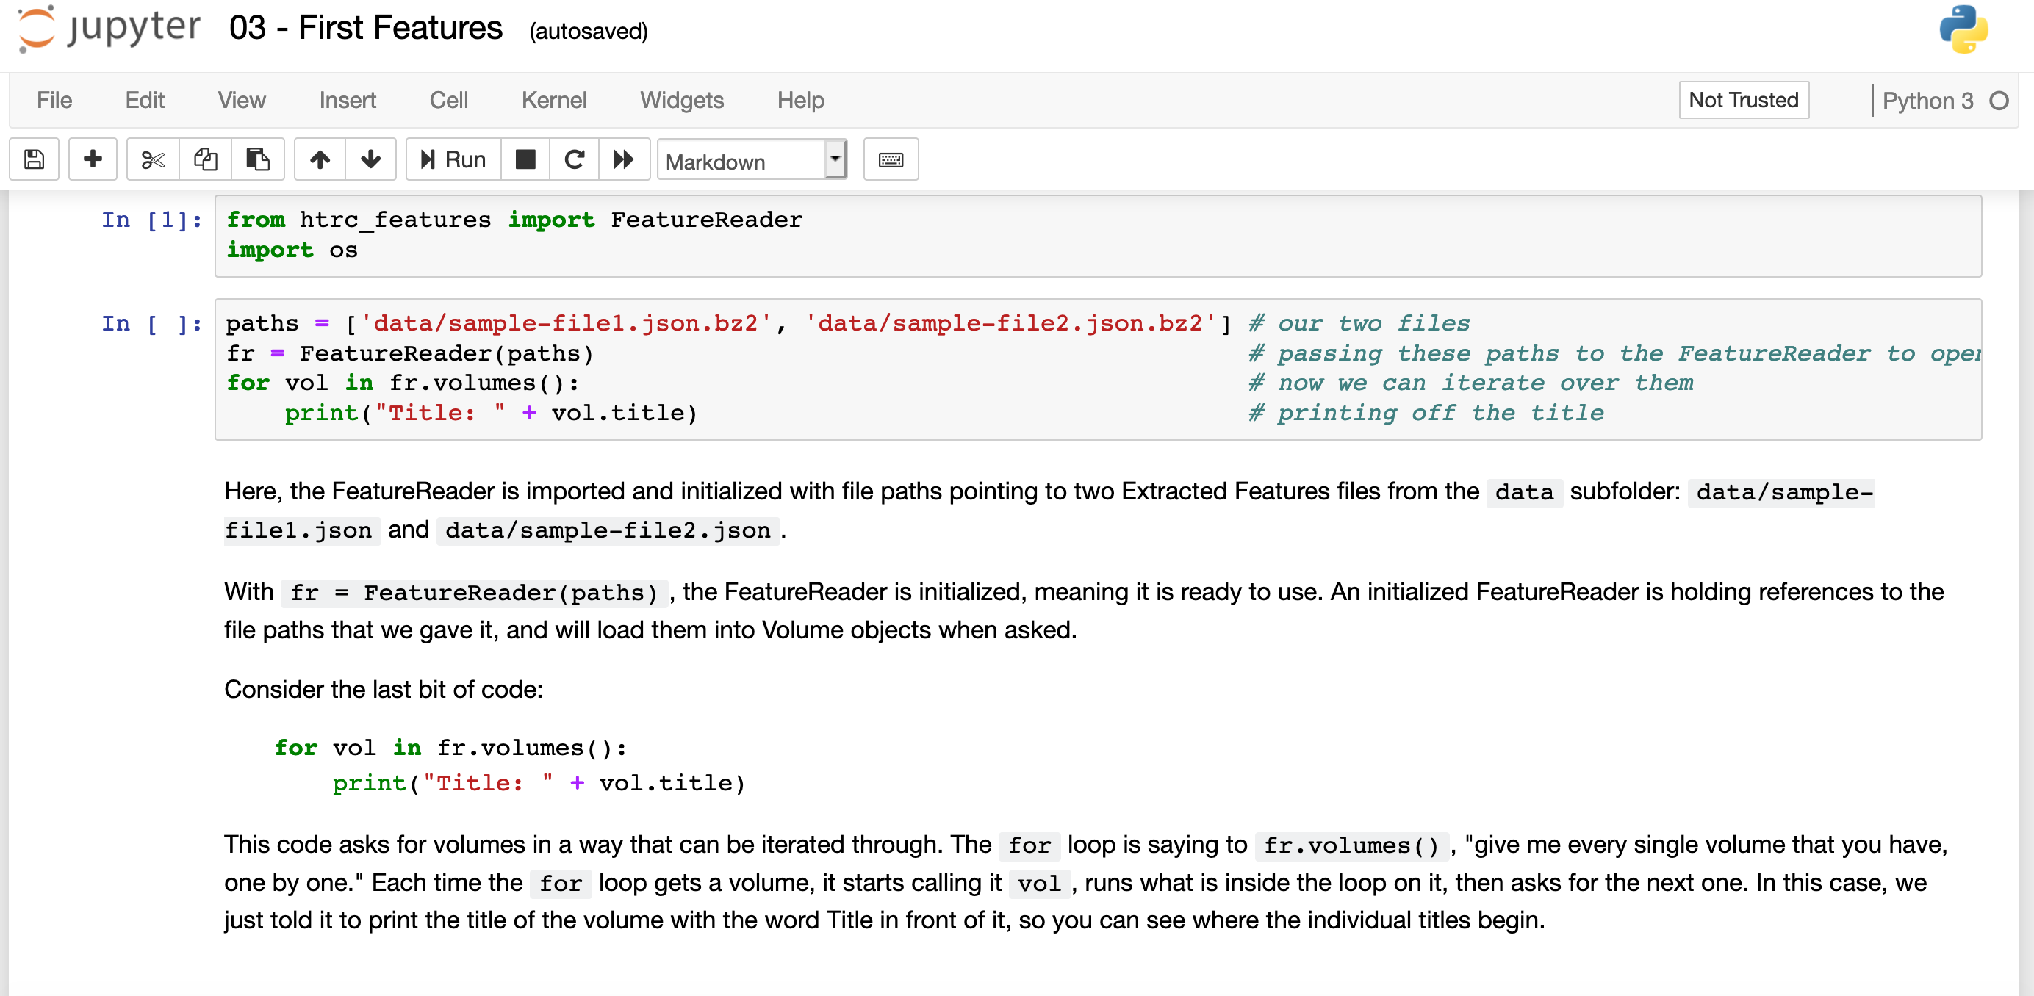
Using Python: Jupyter Notebooks
Write and view code an an interactive environment
Mixes Python (and other commands) with space for additional text
Good for teaching and sharing code
We’re using these today!
Notes:
The final way for Python programming that we will discuss today is using Jupyter notebooks. Jupyter notebooks are interactive environments that allow someone to put in blocks of code interspersed with other text. They are good for teaching and sharing code because of the way they plainly show all of the dependencies—in other words, the additional pieces that have to be installed in order for the code to run—along with the code and those bits of description.
Our afternoon activities will largely be done in Jupyter notebooks.

Slide 84
Hands-on: Learning the Jupyter environment
Handout p. 7
Get comfortable with Jupyter notebooks with the “Learning the Environment” notebook
Website: https://go.illinois.edu/htrc-workshop
Launch Binder
01-learning-jupyter-environment.ipynb
Notes:
ACTIVITY
This activity includes a brief notebook that introduces the environment and allows attendees to practice using Jupter notebooks.
From the URL on the slide, click the small “launch binder” button.
Once it loads, select 01-learning-jupyter-environment

Slide 85
Hands-on: Map location entities
Handout p. 7
Geocode and map the location entities output from the HTRC Named Entity Recognizer.
Website: https://go.illinois.edu/htrc-workshop
Launch Binder (if not already launched)
02-geocoding-module.ipynb
Notes:
ACTIVITY
In this activity learners will work with the CSV file output by the Named Entity Recognizer algorithm when run over The Modern Traveller workset. That CSV file is pre-loaded into binder for the workshop.
From the URL on the slide, click the small “launch binder” button. NOTE – if the binder session is still active, attendees should work directly from Binder and not return to the GitHub link on the slide
Once it loads, select 02-geocoding-module.ipynb

Slide 86
Key methods in text analysis
Representing text data – Bag of words
Text is represented by the words and number of time they occurred, disregarding grammar and word order
Notes:
Next, we’re going to look at methodological approaches for text analysis. We’ll start with 2 ways of representing text data. The first is called a bag-of-words model.
“Bag-of-words” is a concept where, prior to analysis, the data is modeled such that grammar and word order of the original text are disregarded and frequency is maintained.
Some algorithms use this “bag-of-words” representation in order to crunch the data.

Slide 87
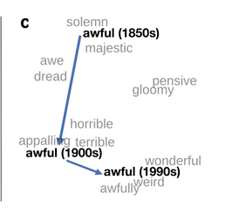
Key methods in text analysis
Representing text data – Word vector embeddings
Each word is represented by a number that reflects multi-dimensional information about its use in the text (i.e. to measure similarity between 2 words)
https://nlp.stanford.edu/projects/histwords/
Notes:
Another way to represent text data for algorithmic use is through word vector embedding. Whereas in a bag of words model word order is ignored, in a word vector embedding, each word is represented by a number that reflects multi-dimension information about its use in the text.
Imagine a multi-dimensional space, and then for each word in our data, we are going to place it within this space based on its use. This example on the slide sort of shows this multi-dimensionality. We see words that are similar clustering together.

Slide 88
Key methods in text analysis
Analyzing text data – Natural Language Processing
Using computers to understand the meaning, relationships, and semantics within human-language text
Named entity extraction: what names of people, places, and organizations are in the text?
Sentiment analysis: what emotions are present in the text?
Stylometry: what can we learn from measuring features of style?
Notes:
First, let’s look at some key approaches to text analysis. One key approach is Natural Language Processing (NLP), meaning using computers to understand the meaning, relationships, and semantics within human-language text. Generally for natural language processing, full text is needed. It is not a bag-of-words method. Some common, specific methods under NLP are:
Named entity extraction, which uses computers to learn about what names of people, places, and organizations are in the text.
Sentiment analysis, which uses computers to explore what emotions are present in the text.
Stylometry, which uses computers to speculate who wrote the text based on language style.

Slide 89
Key methods in text analysis
Analyzing text data – Machine Learning
Training computers to recognize patterns
Topic modeling: What thematic topics are present in the text?
Unsupervised machine learning
Naïve Bayes classification: Which of the categories that I have named does the text belong to?
Supervised machine learning
Notes:
Another key approach to text analysis is Machine Learning, which is training computers to recognize patterns in text without explicit human programming. Machine learning can either be unsupervised (with minimal human intervention) or supervised (with more human intervention). Here are some common, specific methods that are based on machine learning:
Topic modeling, which explores the thematic topics present in the text. Remember that topic modeling is a bag-of-words approach.
Naïve Bayes classification, which explores the categorization of texts, i.e. determining what categories that the researcher have named does a certain text belong to.

Slide 90
Case studies: identify the methods
Handout p. 7
Look back at all 3 case studies
Then characterize the methods used:
What methods did they each use?
Can you tell how their text data was represented? (Bag of words, word embeddings)
Notes:
We are going to pause to identify the methods used in all three of the case studies. Read through them and see if you can determine the methods they used, and whether you can tell how their data would have been represented for their analysis.

Slide 91
Break (20 minutes)

Slide 92
Text analysis workflows

Slide 93
In this section we will…
Get experience with HTRC Extracted Features
Perform exploratory data analysis
Examine a text analysis workflow/pipeline

Slide 94
The toolkit
Researcher-dependent
Requires understanding of statistics
Often draws on expert collaborators
Consists of command line tools and programming languages
Notes:
This toolkit is highly dependent on the individual. Generally, the toolkit will require the researcher to have an understanding of statistics in order to be useful. A researcher may also rely on expert collaborators to wield some of the tools. The toolkit itself is made up primarily of command line tools and programming languages the researcher uses to process and analyze the textual data.
Note: If asked some common tools and programs include: Command line skills, Python and/or R, Visualization tools like Gephi or d3.js, or packages such as Stanford NLP or MALLET.

Slide 95
Exploratory data analysis
Approach for getting familiar with data
Easier to recognize patterns (and problems)
Hard to see trends in a spreadsheet or text file!
There are whole books about it
Strategies:
Plot raw data
Plot simple statistics
Compare plots to look for patterns
Notes:
Let’s dive more deeply into the idea of visualization as an exploration strategy.
Exploratory data analysis is an approach to becoming familiar with a dataset
The idea behind exploratory data analysis is that it is difficult to grasp the contents of a dataset by just reading a spreadsheet or looking through files, especially when one is working at a large scale.
There are whole books written about exploratory data analysis. This discussion barely scratches the surface.

Slide 96
Features in the HTRC
HTRC Extracted Features dataset
Downloadable
Structured data consisting of features
From 15.7 million volumes
https://analytics.hathitrust.org/datasets#ef
Notes:
This concept of translation to features is especially important in the HTRC, where a dataset of Extracted Features has been made available.
Extracted Features dataset is one way the HTRC tries to facilitate text analysis outside of pre-built tools to give researchers more flexibility for their work.
The dataset is a downloadable, structured dataset in a JSON file consisting of 5 billion pages within 13.6 million volumes of content, pulled from the entire HT corpus.
The link to the Extracted Features dataset webpage is shown here on the slide.

Slide 97
HTRC Extracted Features (EF)
The features are
Selected data and metadata
Extracted from raw text
Position the researcher to begin analysis
Some of the preprocessing is already done
Form of non-consumptive access
Notes:
The “features” that are extracted are page- and volume-level data and metadata pulled from the raw text. This information positions the researcher at a point where they can begin their analysis because some of the pre-processing has been done: The text has been tokenized, and some things like counts and part-of-speech tagging is already done. It’s a form of non-consumptive access that allows the researcher to analyze the entire corpus through the extracted content without having access to the full, expressive text.

Slide 98
Extracted Features model
Extracted Features File (for 1 volume from HathiTrust)
Volume metadata
Page features
Page 001
Page metadata
Header data
Body data
Footer data
Page 002
Page metadata
Header data
Body data
Footer data
Notes:
This diagram shows the nested structure of an extracted features file. (JSON, like XML, is nested.) One file corresponds to one volume from HathiTrust. Then there is metadata the describes the entire volume. And then there is section for page features. It is broken down by page in the volume. Each one of these page-level sections includes metadata about the page. It’s also subdivided even further into the header, body, and footer. For each of those there is page-section information, like the number of tokens, what those tokens are and their part of speech, and the number of times each token appears.

Slide 99
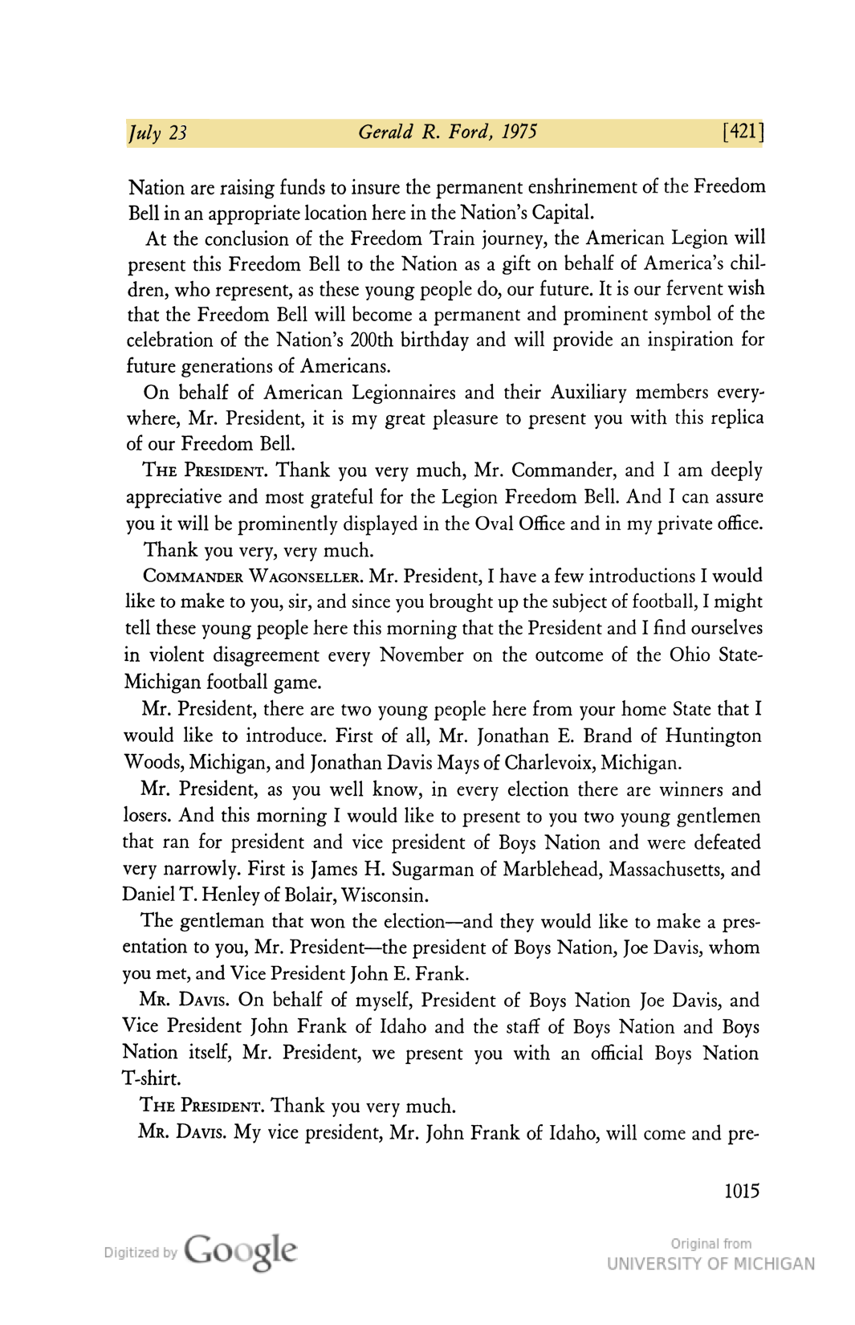
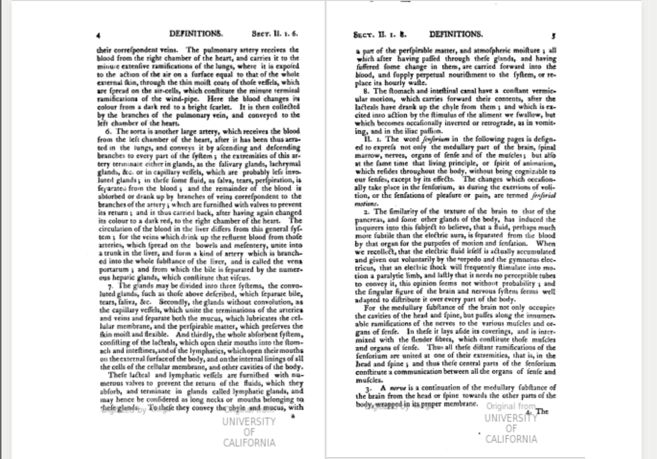
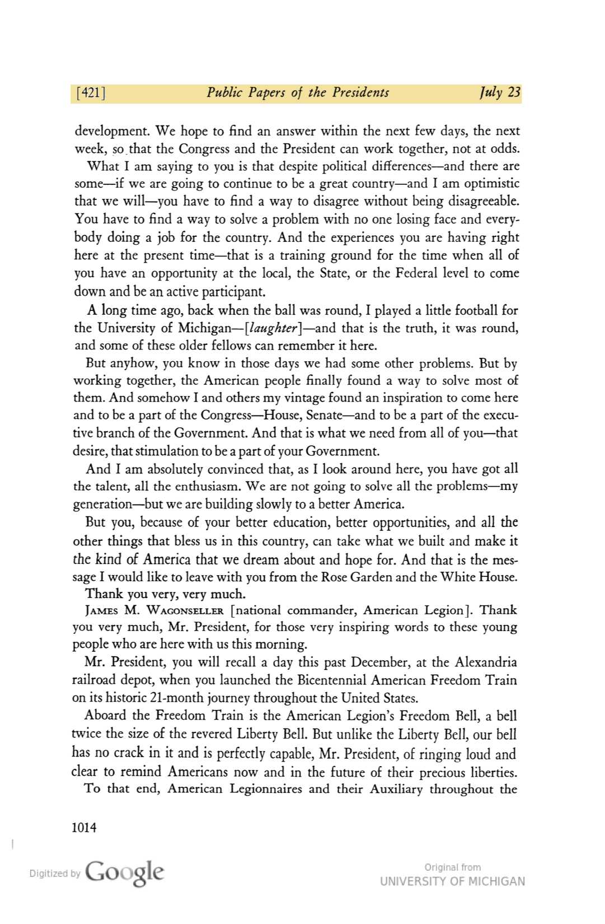
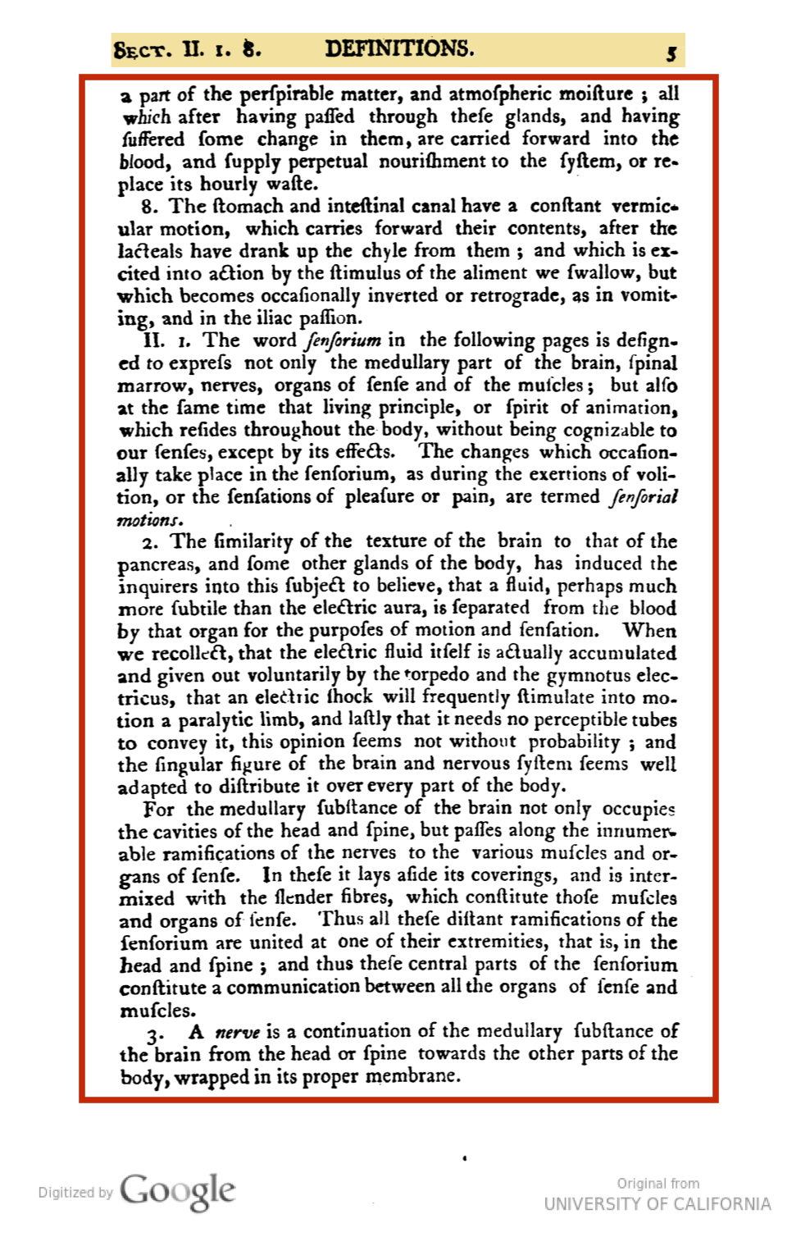
Header, body, footer?
Notes:
As we’ll see, Extracted Features pull out metadata for each section of each page (header/footer/body).
The image on the screen shows the different sections of two pages from Public papers of the presidents of the United States (Gerald R. Ford volume, book 2).
EF help the researcher navigate the para-textual information to get to the pieces most relevant to them.

Slide 100
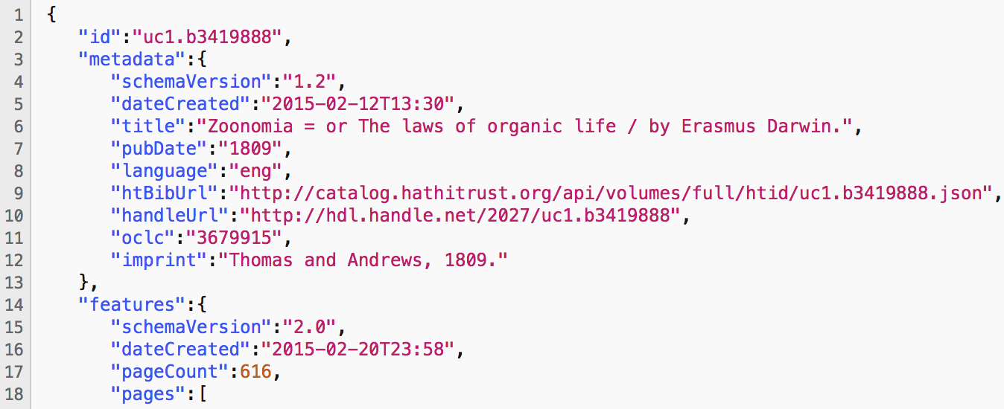
Volume metadata
Pulled from bibliographic metadata
Title
Author
Language
Identifiers
Notes:
At the volume-level, the features are mostly pulled from the bibliographic metadata. They include things like title, author, and language that are included in the library catalog metadata. They also include the unique identifiers for the volume, such as the HT ID, which is consistent across HT tools and services, and the OCLC number.
You can see an example of volume level metadata in the Extracted Features JSON format on the slide.

Slide 101
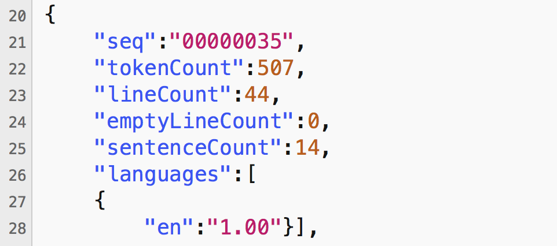
Page metadata
Page sequence
Computationally-inferred metadata
Word, line, and sentence counts
Empty line count
Language
Notes:
For each page in the volume, there is also metadata. This includes the sequence of the page in the volume, as well as computationally-inferred metadata, such as the number of words, lines, sentences, and empty lines on the page, as well as the language for the page in question.
You can see an example of the metadata included for each page within an Extracted Features file.
For the language, “en” here means English.

Slide 102
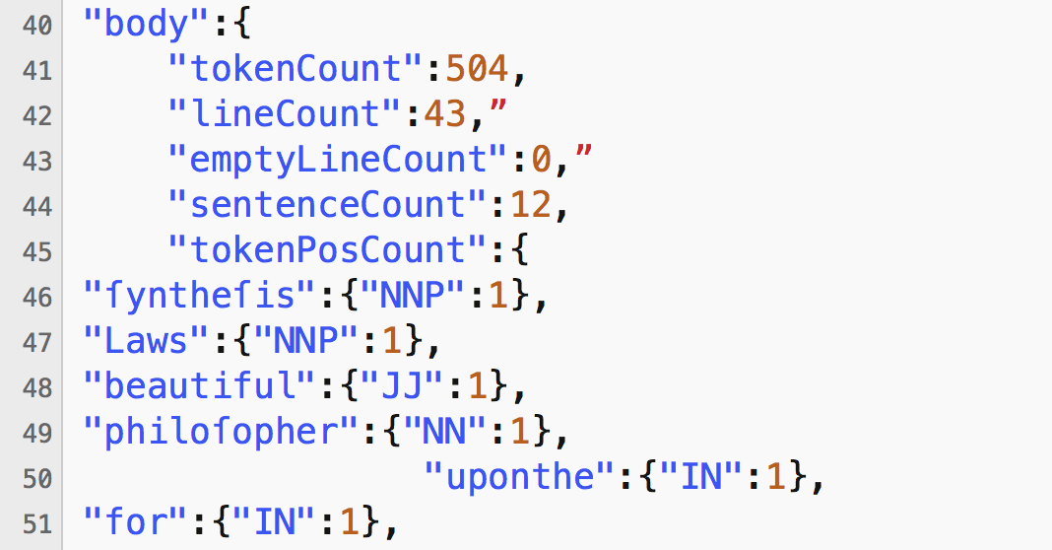
Page section features
Header, body, footer
Line, empty line, and sentence count
Counts of beginning- and end-line characters
Token counts
Homonyms counted separately
Part-of-speech codes are from the Penn Tree Bank
Notes:
The page-level features are further broken down by section of the page. This makes it so a researcher can drop headers and footers easily.
These features include line counts, empty line counts, and sentence counts, and counts of the characters that begin and end lines.
There are also part-of-speech-tagged tokens and their frequencies. The part of speech codes are from the Penn Tree Bank. And homonyms are counted separately: For example, you can differentiate between Rose the name, rose the flower, and rose the verb.
On the slide, there’s an example of the body section for a page in an EF file.
Penn Tree Bank: https://www.ling.upenn.edu/courses/Fall_2003/ling001/penn_treebank_pos.html

Slide 103
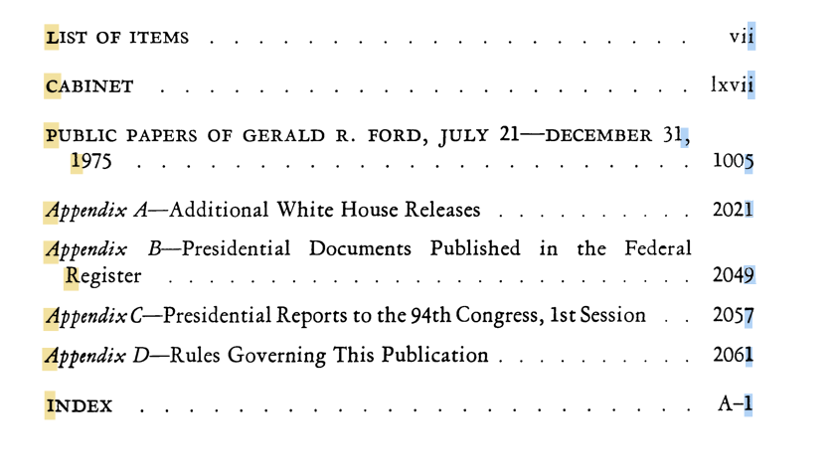
Begin line characters?
Notes:
As we’ll also see, Extracted Features can provide counts of characters occurring at the beginnings and end of lines. This can help identify tables of contents, indices, and title pages, as well as to differentiate poetry from prose, because they all have notable different patterns in the types of characters that occur at the beginnings and ends of lines. For example, we can notice some patterns here from the table of contents of Public papers of the presidents of the United States (Gerald R. Ford volume, book 2). Or, for another example, English-language poetry from some time periods is highly likely to start each line with a capital letter, and end each line with a lowercase letter or punctuation mark.

Slide 104
Hands-on: examine an EF file
Handout p. 8
Open the sample file in Box: mdp.39015073767769.json
Review the file and see if you can find:
The OCLC number
How many lines are in the body of page sequence 00000005
Notes:
ACTIVITY
Attendees have the choice to either view the file in Box or to download it and then open it
It will render most nicely in Firefox
Then they should see if they can read through the JSON to find the OCLC number and line in the body of page sequence 00000005

Slide 105
Using HTRC Extracted Features
Identify parts of a book
From descriptive metadata
Perform any method that works with bags-of-words
Topic modeling
Dunning’s log-likelihood
Classify volumes
Compare with bibliographic metadata
Notes:
Using the HTRC Extracted Features, a researcher can do things like identify the parts of a book from the computationally-derived descriptive metadata.
They can also perform any algorithm that relies on the bag-of-words model, including topic modeling and Dunning’s log-likelihood. Because word order is not preserved, they cannot be used for things where that info is important, like in sentiment analysis.
The researcher could also try a machine learning project to validate the bibliographic metadata. We’ll see an example of this later.

Slide 106
HTRC Feature Reader Python library
Python library for working with HTRC Extracted Features
Code to facilitate research using the JSON files
Install using a package manager, like pip
Source code lives on Github
Requires Pandas to run
pandas = Python library for working with data
Notes:
Today we will work with HTRC Feature Reader, which is a Python library for working with HTRC Extracted Features.
You can analyze the Extracted Features without this library, but using the library allows us to incorporate some already-written code into our analysis.
Because it’s a specialized library and is not standard in Python, it will need to be installed.
We’ll also need to have the package Pandas installed in order to use the Feature Reader because it makes use of some Pandas functions. Remember that Pandas is another Python library for working with data. For us, it’s included in Python Anywhere, so we won’t need to install it today. (But if you’re doing this on your local install of Python on your own machine, you may need to install Pandas.)

Slide 107
Accessing Extracted Features
Entire set is 4 TB; download what you need
Need to know the rsync paths to the EF files you want to download
Use Feature Reader id_to_rsync function to get paths, then rysnc
Use the HTRC EF Download Helper algorithm to generate a shell script to rsync EF, then run the resulting file from the command line sh polisci.sh
Notes:
The HTRC Extracted Features files are generated in bulk, and they are sitting on a server operated by HTRC. Altogether, the existing 15.7 million EF files take up 4TB, so most researchers are downloading only what they need.
Extracted Features files are downloaded using a command-line utility called rsync. Similar to ftp, rsync is a way of transferring files from one machine to another.
Just like with building a workset, you’ll need to identify the HathiTrust IDs for the volumes you would like to download. You have a few options. First, you could create a workset with your volumes of interest, and then use the EF Download Helper algorithm to generate a shell script containing the commands to rsync all of the files. Or you can use the Feature Reader Python library’s built-in “id_to_rysnc” function to output an rsync path.

Slide 108
Accessing Extracted Features
Files sync in pairtree format
File storage format
Nested directories, broken down by characters in file name
https://wiki.ucop.edu/display/Curation/PairTree
Notes:
For our activity, we have Extracted Features files already loaded for you to use. If you download them yourself, you should know that they come in a directory structure called pairtree, which is an efficient way to nest directories based on the name of the file. We won’t go into much detail here, but just be aware that if you do download the files yourself, you may need to spend a few minutes understanding pairtree format in order to make sense of the directory structure.

Slide 109
Hands-on: Analyzing Extracted Features
Handout p. 8
Work with HTRC Extracted Features files to understand the data model and basic Python programming for analyzing text data.
Website: https://go.illinois.edu/htrc-workshop
Launch Binder (if not already launched)
03-ef-activity.ipynb
Notes:
ACTIVITY
In this activity learners will work with the Extracted Features files that correspond to The Moden Traveller workset.
From the URL on the slide, click the small “launch binder” button. NOTE – if the binder session is still active, attendees should work directly from Binder and not return to the GitHub link on the slide
Once it loads, select 03-ef-activity.ipynb

Slide 110
Case studies: text analysis pipelines
Handout p. 8
Go back to the Transformation of Gender case study
Also open this page: https://github.com/dbamman/book-nlp
Then can you:
Explain the pipeline to your neighbor?
What tools or steps does it include?
Notes:
Finally, let’s spend more time on case study 3. We’re going to supplement the information in the case study with the documentation on the GitHub page for BookNLP, so please open this URL as well. After reading both, can you explain the pipeline to your neighbor and the tools and steps it includes?

Slide 111
Other HTRC tools and services

Slide 112
HathiTrust data access options
Method | Data | Description | Rights status | Restrictions
HT dataset request | Full text OCR | Download page images and plain text OCR | Public domain | Depends on your university
HT Data API | Full text OCR, page images | Download page images and plain text OCR | Public domain | Non-Google digitized only
HTRC Algorithms | Full text OCR (not viewable) | Analyze a workset using off-the-shelf tools | All | Data can be computed on, but is not exposed
HTRC Extracted Features | Abstracted text and metadata | JSON files for each of 15.7 million volumes in HathiTrust | All | Data is preprocessed
HTRC Data API | Full text OCR | Analyze plain text OCR | All for HT members; else public domain | For use in a Data Capsule only
Notes:
So far we’ve focused on the HTRC Algorithms and Extracted Features. Before we wrap-up, let’s learn about 2 other data access options: HTRC Data Capsules and a HathiTrust dataset request.

Slide 113
Secure Data Capsules
Secure analysis environments
Linux virtual desktop
Protocols for data import/export
https://analytics.hathitrust.org/staticcapsules
Notes:
Self-directed researchers may want to take advantage of the HTRC’s Data Capsules environments. They are secure, virtual desktops for analyzing HathiTrust context. The screenshot on the slide shows, the desktop of a capsule. The capsules run the Ubuntu operating system. The researcher can operate the capsule as if it were their personal desktop, There are protocols for data import and export that are in place for data security reasons. Researchers from HathiTrust institutions can request capsules that have access to the entire HathiTrust corpus.

Slide 114
Custom dataset request
For researchers who need public domain data only
Downloadable, OCR and metadata
Request procedure
Some limitation based on Google-digitization
https://www.hathitrust.org/datasets
Notes:
Researchers also have the option to request a custom dataset from HathiTrust. Datasets can be downloaded to the requesters computer, and so they can only include full-text of public domain content. There is a request procedure to get access to the dataset, and a dataset can include up to the entire public domain contents of HathiTrust. There are limitations for access to Google-digitized content based on whether a requester’s institution has signed an agreement with Google, so if your institution has not signed an agreement, that may be something you ask about pursuing.

Slide 115
Dataset help
Assistance crafting lists of volume IDs
For HathiTrust custom dataset requests
feedback@issues.hathitrust.org
For HTRC worksets
htrc-help@hathitrust.org
Notes:
HTRC can help those needing assistance creating a list of HathiTrust volume IDs for either a custim dataset request from HathiTrust or for an HTRC workset. Contact HathiTrust’s help address for custom datasets and HTRC’s help email address for worksets, but the same people will give you assistance in either case. (HathiTrust just tracks these requests separately.)

Slide 116
Advanced Collaborative Support awards
Competitively awarded “grants”
Time and resources awarded
In the 5th round now
Read the descriptions and reports: https://wiki.htrc.illinois.edu/x/CADiAQ
Notes:
Researchers who have cutting-edge projects or a projects not currently possible with existing tools and services can apply for Advanced Collaborative Support from HTRC during it’s call for projects that go out about once per year. ACS awardees get access to HTRC staff time and compute resources to complete their project. We’re in the 5th round now. If want to learn more about the projects or get a feel for the kind of research that has been done with HTRC, you might interested to read the descriptions and reports on the HTRC’s wiki.

Slide 117
ACS project example
The Chicago School: Wikification as the First Step in Text Mining in Architectural History
Explored history of the term “Chicago School” through the corpus
Used wikifier tool to link named entities to Wikipedia entries
Found different types of “Chicago Schools” (e.g., the Chicago School of bone breakers)
Compute-intensive, relied on access to high performance computers
Found use of the term as applied to architecture dating to 1889
Researcher: Dan Baciu
Notes:
Here’s an example of an ACS project from a researcher named Dan Baciu. Dan is an architectural historian studying usage of the term “Chicago School.” Even though Dan was most interested in uses related to architecture, the term was also applied to many other kinds of Chicago Schools, such as the Chicago School of Bone Breakers. So he not only needed to identify the term ”Chicago School,” but use Natural Language Processing techniques and a tool called the wikifier to link the instances of Chicago School with a Wikipedia entry. This was a compute-intensive project that required access to high performance computers. Dan found the term as it relates to architecture dating to 1889, which was earlier than most known references.

Slide 118
Documentation
https://wiki.htrc.illinois.edu/
Further information
Technical documentation
Step-by-step guides
Notes:
Use the HTRC wiki to find more information about HTRC, its tools and data, and how others have used HTRC for their research. The wiki includes step-by-step guides for using HTRC.

Slide 119
Office hours
Every 3rd Wednesday from 3-4 p.m. ET
Ask questions, connect with other researchers
go.illinois.edu/htrchelp-live
Notes:
HTRC offers office hours every third Wednesday of the month from 3-4 Eastern Time. Depending on how many people are there, we sometimes have a group conversation, but mostly it’s one a few people coming into the Zoom meeting, asking their questions, and then logging off. You don’t need to RSVP, but it’s generally best to have a specific question in mind.

Slide 120
Help email
htrc-help@hathitrust.org
For general inquiries, troubleshooting, and research consultations
Notes:
To report a bug, as a question, or schedule a research consultation, contact HTRC using htrc-help@hathitrust.org.

Slide 121
Questions?
htrc-help@hathitrust.org
https://teach.htrc.illinois.edu
Materials modified from curriculum funded by
award #RE-00-15-0112-15
Notes:
Follow-up questions should also be directed to the general HTRC help email address. This curriculum is modified from an IMLS-funded workshop series. You can access all of the materials generated in for that grant at teach.htrc.illinois.edu.

Slide 122
Bibliography
Bode, K. (2019). Why you can’t model away bias. Preprint: Modern Language Quarterly 80.3. https://katherinebode.files.wordpress.com/2019/08/mlq2019_preprintbode_why.pdf.
Denny, M. J. and Spirling, A. (2017). Text Preprocessing for Unsupervised Learning: Why It Matters, When It Misleads, and What to Do about It. https://ssrn.com/abstract=2849145.
Moretti, F. (2013). Distant reading. Verso Books.
Rockwell, G. (2003). What is Text Analysis, Really? Literary and Linguistic Computing, 18(2), 209–219. https://doi.org/10.1093/llc/18.2.209.

